Slide 1

DKTE Society’s Textile and Engineering Institute, Ichalkaranji
Department of Information Technology
2020-2021
Project Presentation
YEAR 2020-2021

Slide 2
Under The Guidance of Mr. A. S. Shelar
Group Members:
1. Mrunali Bhojraj Lipte 17UIT11027XX
2. Anjali Shahaji Patil 17UIT11042XX
3. Mrunali Rajendra Patil 17UIT11044XX
4. Snehal Maruti Powar 17UIT51048XX
5. Ruturaj Amar Mudholkar 17UIT72005XX

Slide 3
Project Title Assistive Vision : Image Caption Generator

Slide 4
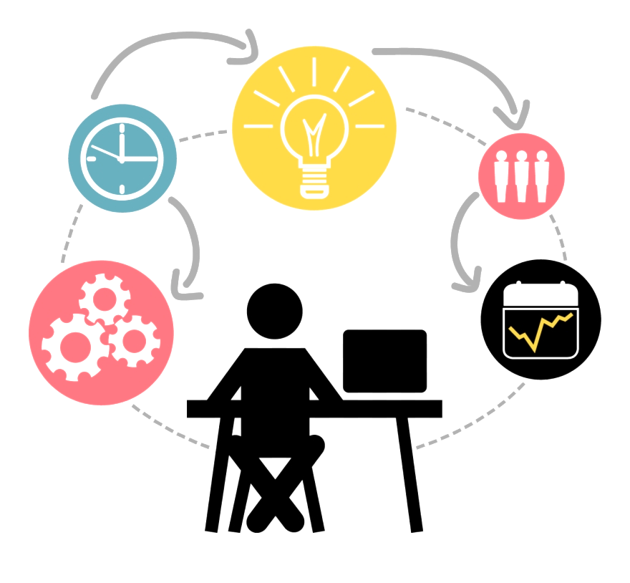
Problem statement
Design and Develop a system, which generate the description of an image using Convolutional Neural Network (CNN)

Slide 5

Abstract
Image caption generator aims to automatically generate a sentence description for an image. The model will take an image as input and generate an English sentence as output, describing the contents of the image. The capturing mechanism involves a tedious task that collaborates both image processing and computer vision. The model is based on a deep recurrent architecture that combines recent advances in computer vision and machine translation and that can be used to generate natural sentence describing an image.

Slide 6

Introduction
For a machine to be able to automatically describe objects in an image along with their relationships or the actions being performed using a learnt language model is a challenging task, but with massive impact in many areas.
For example it could help people with
visually impairment better understand
visual inputs, thereby acting as an assistant
or a guide.

Slide 7
Literature survey of similar systems or related technology
Baby Talk : Understanding and generating simple image description. (Girish Kulkarni, Visruth Premraj, Vicente Ordenz)(2011)
Orial Vinyals: Alexander Toshev, Samy Bengio, Dumitru Erhan), Show and Tell : A description must capture not only the objects contained in an image, but it also must express how these objects relate to each other as well as their attributes and the activities they are involved in.(2015)
A Real-Time Image Caption Generator: Created a first mobile device based application to introduce possible use cases to perform well in real time and maintain to object high quality caption(Pranay Mathur, Aman Gill, Aayush Yadav, Anurag Mishra, Kumar Bansode )(2017)

Slide 8

Limitations of existing system
Automatic image captioning is a relatively new task, thanks to the eﬀorts made by researchers in this ﬁeld, great progress has been made. In our opinion there is still much room to improve the performance of image captioning.

Slide 9
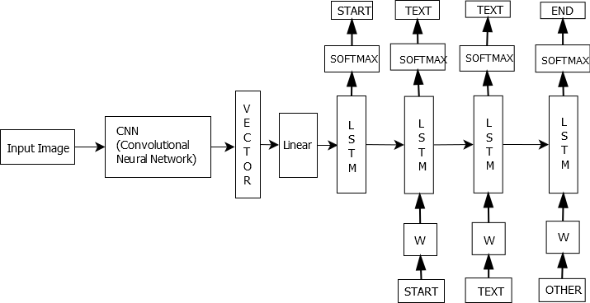
System Architecture

Slide 10

Objectives
To understand the role of basic knowledge representation, problem solving, and learning methods of artificial intelligence.
To provide an assistive vision to the blind people.
To address the complexity of image captioning and decoding it with accuracy.

Slide 11
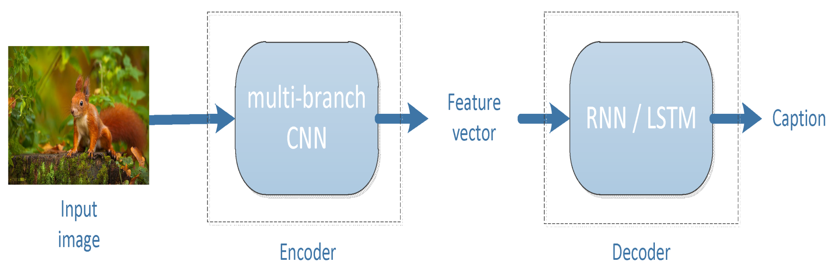
Expected input and output
Input: Validating Image
Output: A Caption generated by software for a input image

Slide 12
IMPLEMENTATION
The implementation of the model was done using the Python environment. Keras 2.4 was used.
TensorFlow library is installed as a backend for the Keras framework for creating and training deep neural networks. TensorFlow is a deep learning library developed by Google. It provides heterogeneous platform for execution of algorithms.
Steps:
1 Model Building
2. Training the model
3.Testing the model

Slide 13
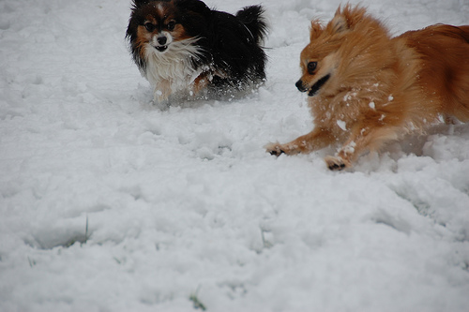
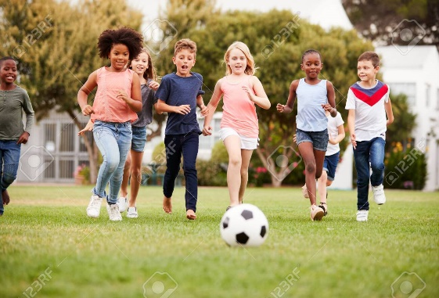
TESTING
Testcase | Input | Expected output | Status
 |  | The small dogs play in the snow | pass
2. |  | Children are playing with football on grass | pass

Slide 14
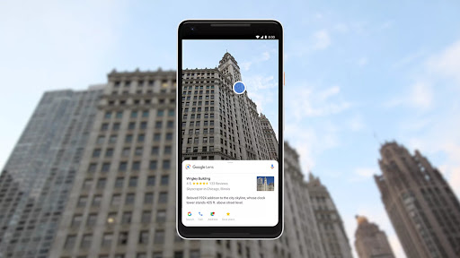
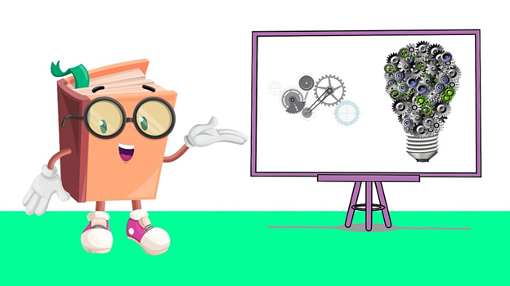
Applications
Image Search Tools :-
Caption can be generated from
image at first and search can be
performed on the basis of caption
that is generated from image.
Guidance Devices :-
Caption can be generated from image and converted into voice, these can be provided for blind people by guiding them without any support.

Slide 15
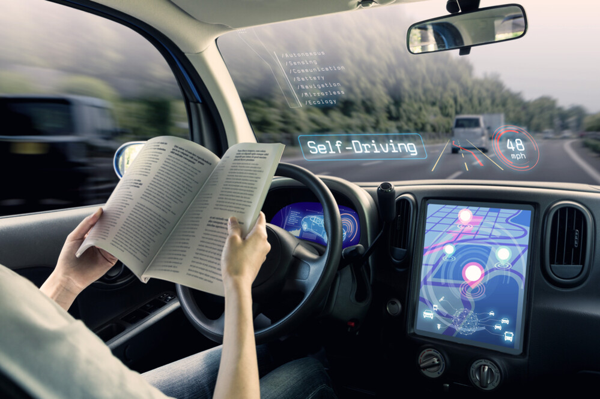
Applications
Self Driving Cars :-
All self drive cars are using image/video processing with neural network to attain their goal in order to boost self driving.

Slide 16
References
[1] Kulkarni G, Premraj V, Dhar S, Li S, Choi Y, Berg AC, Berg TL (2011) Baby Talk: Understanding and Generating Image Descriptions. IEEE Conference on Computer Vision and Pattern Recognition (CVPR) (20-25 June 2011)
[2] Orial Vinyals , Alexander Toshev, Samy Bengio, Dumitru Erhan(2015)
[3] Show and Tell : A Neural Image Caption Generator(IEEE-2015)
[4] Pranay Mathur, Aman Gill, Aayush Yadav, Anurag Mishra and Kumar Bansode , Camera2Caption: A Real-Time Image Caption Generator(International Conference on Computational Intelligence In Data science-2017)
[5] N. Komal Kumar, D. Vigneswari, A. Mohan, K. Laxman, J. Yuvraj , Detection and recognition of Objects in Image Caption generator system : A deep learning approach(IEEE-2019)

Slide 17
Thank You

